Slide 1
Contents
Thévenin Equivalent Resistance
Computing the Thévenin Voltage
Computing the Norton Current

Slide 2
Contents
Thévenin Equivalent Resistance
Computing the Thévenin Voltage
Computing the Norton Current

Slide 3
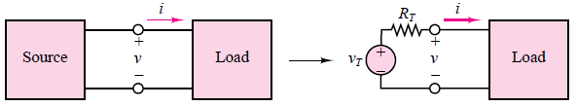
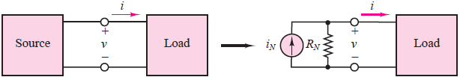
Computing the Norton Current
series circuits - Thévenin theorem
parallel circuits - Norton theorem

Slide 4
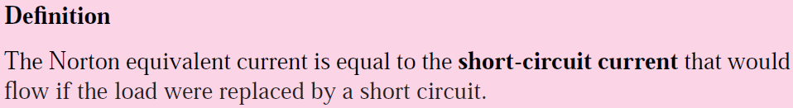
Computing the Norton Current
The computation of the Norton equivalent current is very similar in concept to that of the Thévenin voltage. The following definition serves as a starting point:

Slide 5
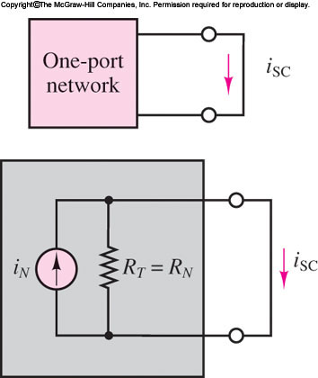
Computing the Norton Current
The computation of the Norton equivalent current

Slide 6
Computing the Norton Current
The current iSC flowing through the short circuit replacing the load is exactly the Norton current iN , since all the source current in the circuit of Figure must flow through the short circuit
iSC = iN

Slide 7
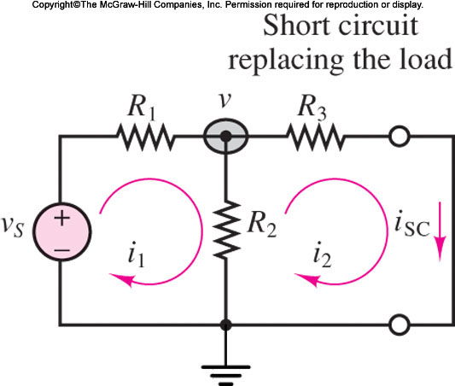
Computing the Norton Current
Consider the circuit of Figure, shown with a short circuit in place of the load resistance. Any of the techniques presented could be employed to determine the current iSC.

Slide 8
Computing the Norton Current
In this particular case, mesh analysis is a convenient tool, once it is recognized that the short-circuit current is a mesh current.

Slide 9

Computing the Norton Current
Let i1 and i2 = iSC be the mesh currents in the circuit
Then the following mesh equations can be derived and solved for the short-circuit current:

Slide 10


Computing the Norton Current
Let i1 and i2 = iSC be the mesh currents in the circuit
An alternative formulation would employ node analysis to derive the equation

Slide 11

Computing the Norton Current
Recognizing that
  iSC = v/R3, we can determine the Norton current to be
  Thus, conceptually, the computation of the Norton current simply requires identifying the appropriate short-circuit current

Slide 12
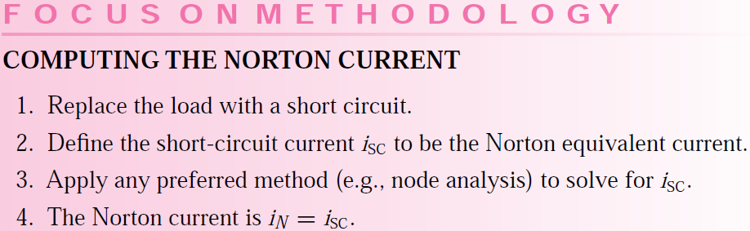
Computing the Norton Current

Slide 13
Norton Equivalent Circuit Problem
Examples

Slide 14
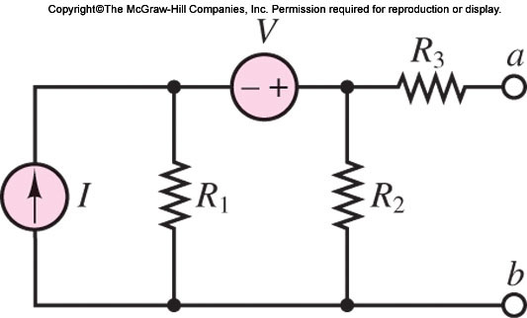
Norton Equivalent Circuit Problem
Determine the Norton current and the Norton equivalent for the circuit of Figure 3.55.(Example 3.21, Page 101)

Slide 15
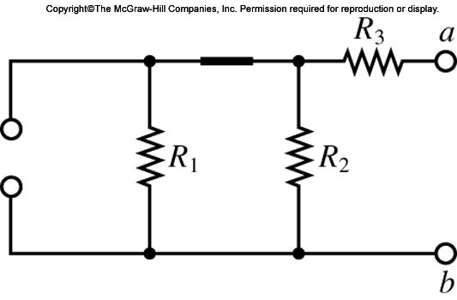
Norton Equivalent Circuit Problem
Determine the Norton current and the Norton equivalent for the circuit of Figure 3.55.(Example 3.21, Page 101)
Equivalent resistance RT

Slide 16
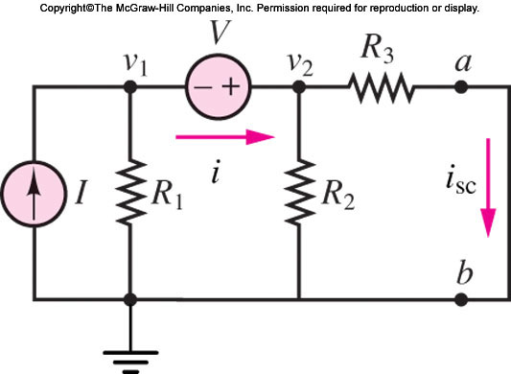
Norton Equivalent Circuit Problem
Determine the Norton current and the Norton equivalent for the circuit of Figure 3.55.(Example 3.21, Page 101)
Circuit of Example 3.21 ready for node analysis

Slide 17
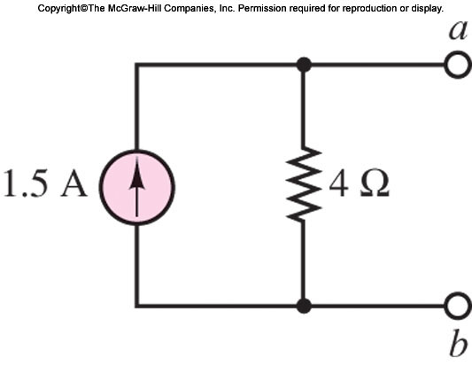
Norton Equivalent Circuit Problem
Determine the Norton current and the Norton equivalent for the circuit of Figure 3.55.(Example 3.21, Page 101)
Circuit of Example 3.21 ready for node analysis

Slide 18
Source Transformations
Illustrate source transformations,
A procedure is very useful in the computation of equivalent circuits,
In some cases, replacement of current sources with voltage sources and vice versa.

Slide 19
Source Transformations
The Norton and Thévenin theorems state that any one-port network can be represented by
a voltage source in series with a resistance, or
a current source in parallel with a resistance,

Slide 20

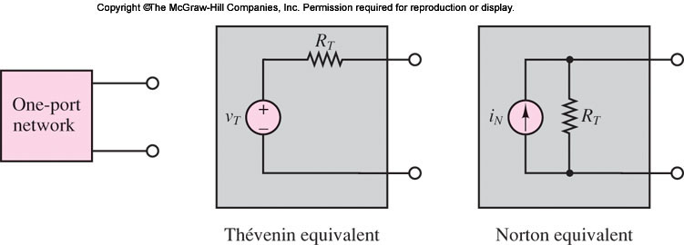
Source Transformations
a voltage source in series with a resistance, or
a current source in parallel with a resistance,

Slide 21
Source Transformations
An extension of this result is that any circuit in Thévenin equivalent form may
be replaced by a circuit in Norton equivalent form, provided that we use the following
relationship:

Slide 22
Source Transformations
The subcircuit to the left of the dashed line in Figure 3.60 may be replaced by its Norton equivalent. Then the computation of iSC becomes very straightforward, since the three resistors are in parallel with the current source and
therefore a simple current divider may be used to compute the short-circuit current.

Slide 23
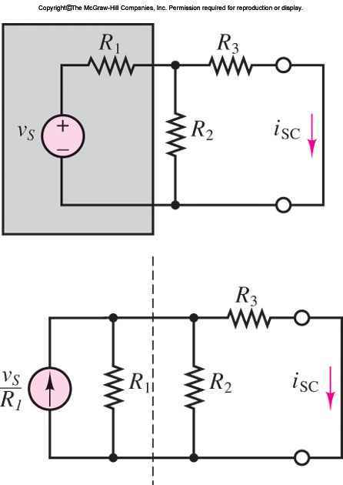
Source Transformations
The subcircuit to the left of the dashed line in Figure 3.60 may be replaced by its Norton equivalent. Then the computation of iSC becomes very straightforward, since the three resistors are in parallel with the current source

Slide 24

Source Transformations
Observe that the short-circuit current is the current flowing through R3;

Slide 25
Source Transformations
Observe that the short-circuit current is the current flowing through R3;

Slide 26
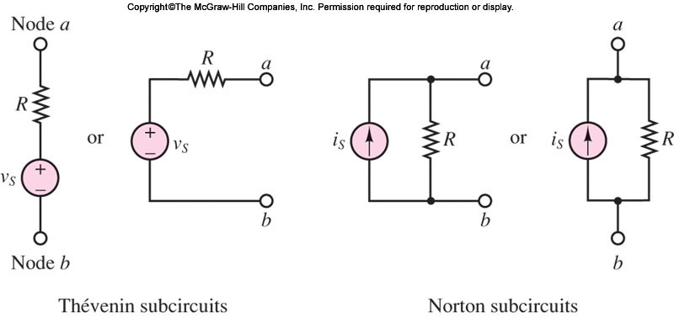
Source Transformations
This source transformation method can be very useful, if employed correctly

Slide 27
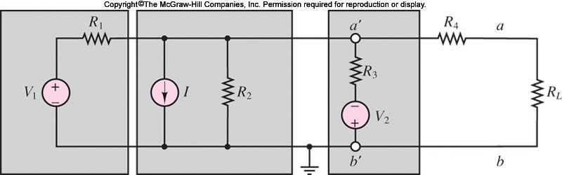
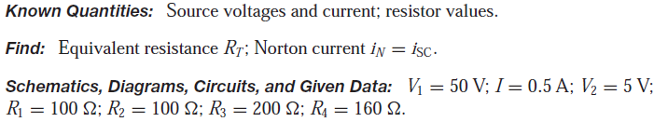
EXAMPLE 3.22 Source Transformations
Compute the Norton equivalent of the circuit of Figure 3.62 using source transformations

Slide 28
EXAMPLE 3.22 Source Transformations
Compute the Norton equivalent of the circuit of Figure 3.62 using source transformations

Slide 29
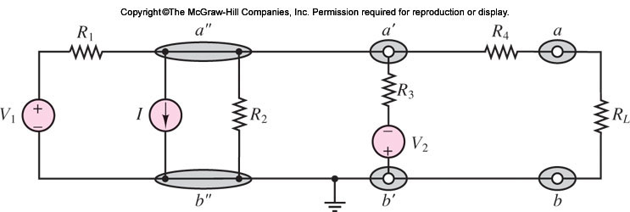
EXAMPLE 3.22 Source Transformations
Compute the Norton equivalent of the circuit of Figure 3.62 using source transformations

Slide 30
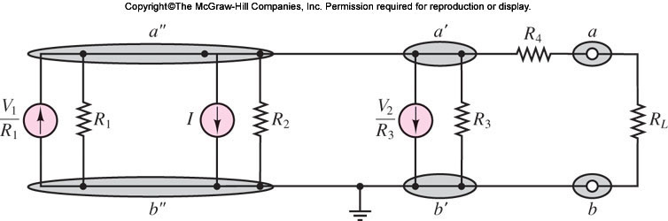
EXAMPLE 3.22 Source Transformations
Compute the Norton equivalent of the circuit of Figure 3.62 using source transformations

Slide 31
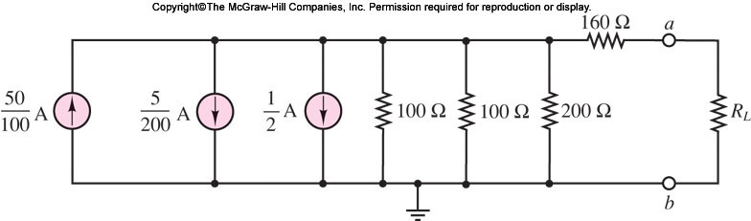
EXAMPLE 3.22 Source Transformations
Compute the Norton equivalent of the circuit of Figure 3.62 using source transformations

Slide 32
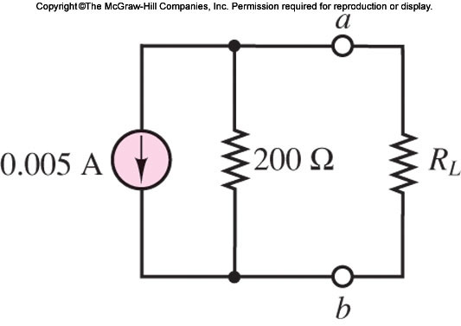
EXAMPLE 3.22 Source Transformations
Compute the Norton equivalent of the circuit of Figure 3.62 using source transformations

Slide 33
EXAMPLE 3.22 Source Transformations
Compute the Norton equivalent of the circuit of Figure 3.62 using source transformations

Slide 34
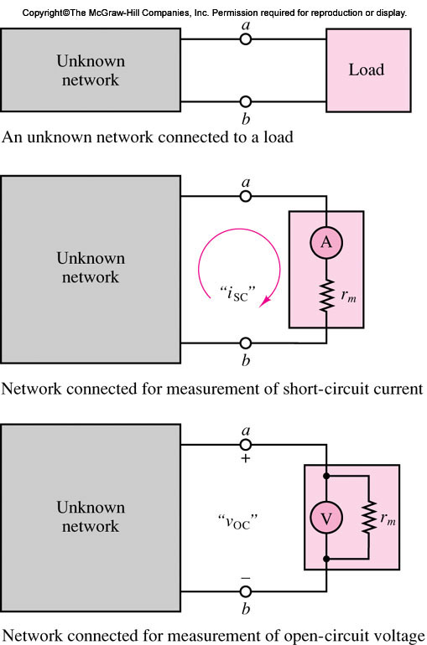
Experimental Determination of Thévenin and Norton Equivalents

Slide 35
References
Giorgio Rizzoni, “Fundamentals of Electrical Engineering”, McGraw- Hill Education, 2009. ISBN. 978-0-07-338037-7
Peyton Z. Peebles (Author), Tayeb A. Giuma, Principles of Electrical Engineering (Mcgraw Hill Series in Electrical and Computer Engineering), Mcgraw-Hill College, 1991.
Allan R. Hambley, Electrical Engineering: Principles and Applications, Prentice Hall, ISBN-0132130068, 9780132130066, 2011.

